Slide 1
Sampling and Quantization

Slide 2
OVERVIEW
Image Formation model
Sampling and Quantization
Representing Digital Images

Slide 3
Image Formation Model
An image is defined by two dimensional function f(x,y).
The value or amplitude of f at spatial coordinates (x,y) is a positive scalar quantity.
When an image is generated from a physical process, its value are proportional to energy radiated by physical source.
As a consequence, f(x,y) must be nonzero and finite
The function f(x,y) may be characterized by two components:
  Amount of source illumination i(x,y) incident on the
  scene being viewed
  Amount of illumination reflected r(x,y) by the objects in the scene.

Slide 4
Image Formation Model
The two function combine as product to form f(x,y):
  f(x,y)=i(x,y) r(x,y)
  Where 0 < i(x,y)< ∞ and 0 <r(x,y)< 1
r(x,y)=0 means total absorption r(x,y)=1 means total reflectance
Intensity of a monochrome image f at (x₀,y₀) is the gray level l of the image at that point
  l=f (x₀,y₀) where Lmin ≤ l ≤ Lmax && Lmin: Positive Lmax: Finite
In practice: Lmin = Imin rmin and Lmax = Imax rmax
The interval [Lmin, Lmax] is called as gray scale and can be shifted to numerical interval [0,L-1]
Where l=0: black and l=L-1: white

Slide 5
Sampling and Quantization
Digital image is created by conveting the continuous sensed data into digital form, which involves two processes:
      Sampling
      quantization.
An image may be continuous with respect to the x and y coordinates and also in amplitude.
To convert to digital form digitize the functions in both coordinates and amplitude
Digitizing the coordinate value is called sampling
Digitizing the amplitude value is called quantization

Slide 6
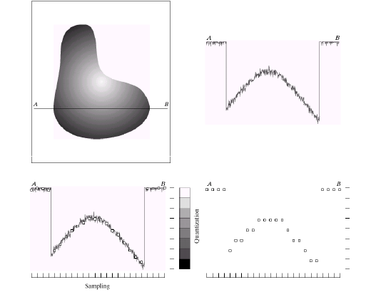
Genearting the Digital Image
(b)
(c)
(d)

Slide 7
Genearting the Digital Image
The one‑dimensional function shown in Fig.(b) is a plot of
amplitute (gray level) values of the continuous image along the line segment AB.
To sample this function, we take equally spaced samples along line AB, as shown in Fig. (c).
  Location of each sample is given by a vertical tick mark in the bottom part.
  The samples are shown as small white squares superimposed on the function.
  The set of these discrete locations gives the sampled function.
  The values of the samples still span (vertically) as continuous range of gray‑level values.

Slide 8
Genearting the Digital Image
In order to form a digital function, the gray‑level values also
must be converted (quantized) into discrete quantities.
The right side of Fig.(c) shows the gray‑level scale divided
into eight discrete levels, ranging from black to white.
The vertical tick marks indicate the specific value assigned to
each of eight gray levels.
The continuous gray levels are quantized simply by assigning
one of the eight discrete gray levels to each sample.
Starting from the top of the image procedure is repeated to form two-dimensional digital image.
Quality of digital images are based on the number of samples and discrete grey levels used.

Slide 9
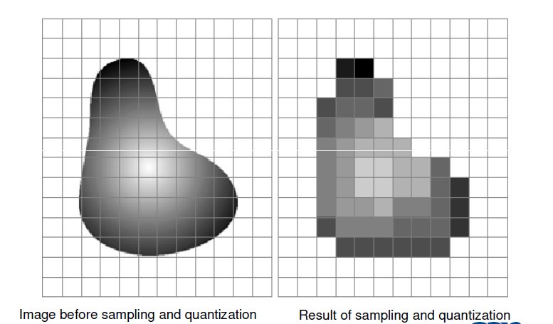
Results of Sampling and Quantization

Slide 10
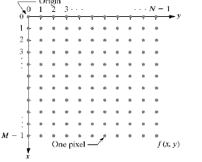
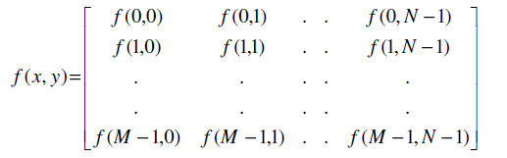
Representing the Digital Image

Slide 11
Representing the Digital Image
Image f(x,y) is sampled and the image has M rows and N columns
The values of the coordinates (x,y) become discrete quantities.
Each element of the matrix array is called image element, picture element, pixel or pel.
The digitization process requires decisions on the values of M, N
and L (number of discrete intensity levels)
No restrictions on M and N other than: M > 0 and N > 0
Due to processing, storage, and sampling hardware considerations, the number of gray levels typically is an integer power of 2, L = 2^{K} where k is number of bits require to represent a gray value
Assume that discrete levels are equally spaced and integers in [0,L-1]

Slide 12
Representing the Digital Image
Number b of bits required to store an image:
b = M x N x k if M = N then b = N² k
Image with 2^{k} gray levels => “k-bit image” (ex: 256 → 8-bit image)
The range of values spanned by the gray scale is called dynamic range of the image
Contrast = difference in intensity between the highest and the lowest intensity levels in an image
High dynamic range => high contrast expected
Low dynamic range => dull, washed-out gray look

Slide 13
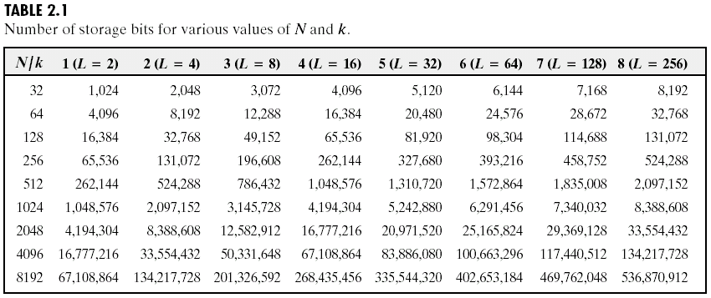
Representing the Digital Image
The number storage bits for various values of N and k

Slide 14
Spatial and Gray – Level Resolution:
Sampling is the principal factor determining the spatial resolution of an image.
It is the smallest detectable detail in an image.
Resolution is the smallest number of discernible line pairs per unit distance.
Gray level resolution is the smallest discernible change in gray level, which is a subjective process
The number of gray levels is usually an integer of power 2 due to hardware consideration.
Common bits are 8,16 bits in gray level

Slide 15
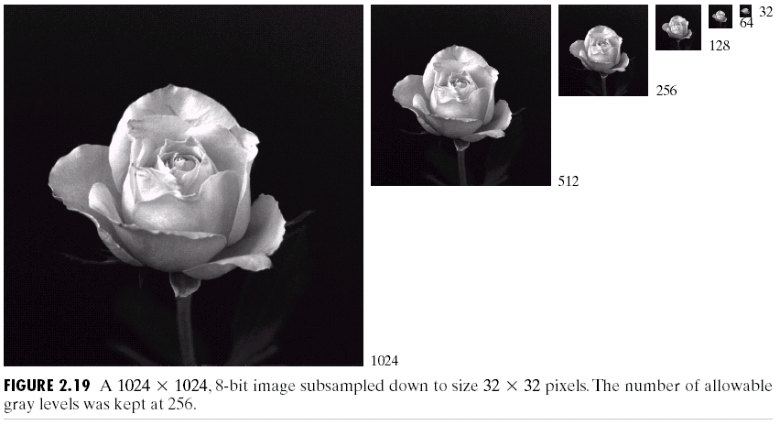
Effect of Spatial Resolution
(Images from Rafael C. Gonzalez and Richard E.
Wood, Digital Image Processing, 2nd Edition.

Slide 16
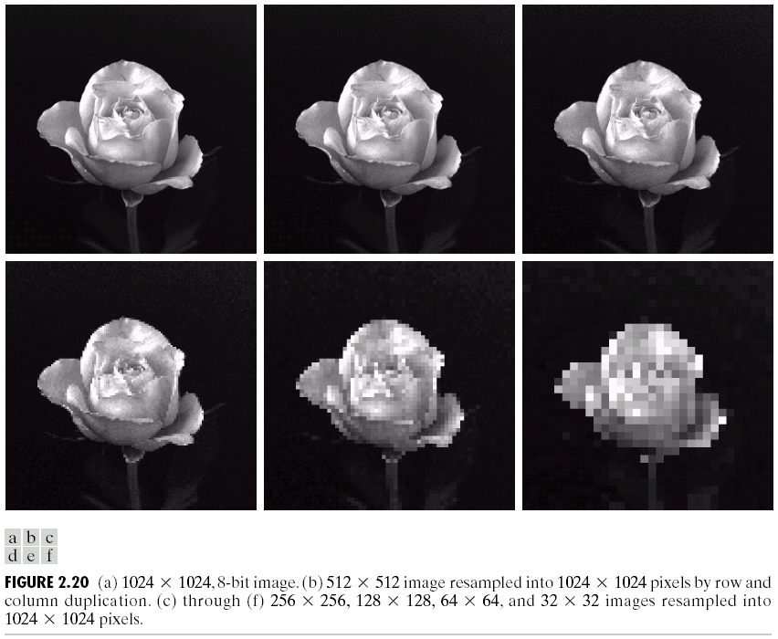
Effect of Spatial Resolution
Detail loss is very small in case of (a), (b) and (c).
Increment of graininess in other images
(Images from Rafael C. Gonzalez and Richard E.
Wood, Digital Image Processing, 2nd Edition.

Slide 17
Image Quantization
Image quantization:
discretize continuous pixel values into discrete numbers
Color resolution/ color depth/ levels:
- No. of colors or gray levels or
- No. of bits representing each pixel value
- No. of colors or gray levels N_{c} is given by
L = 2^{K}
where b = no. of bits

Slide 18
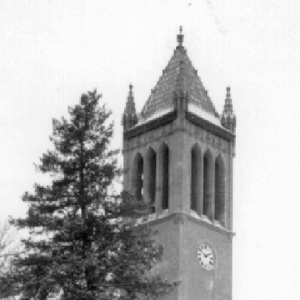


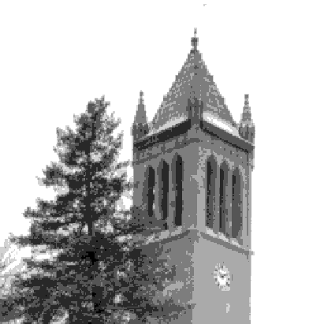
Effect of Quantization Levels
256 gray levels (7 bits per pixel))
256 gray levels (8 bits per pixel)
Where k=7 to 1
256 levels
128 levels
64 levels
32 levels
256 gray levels (6 bits per pixel))
256 gray levels (5 bits per pixel))

Slide 19

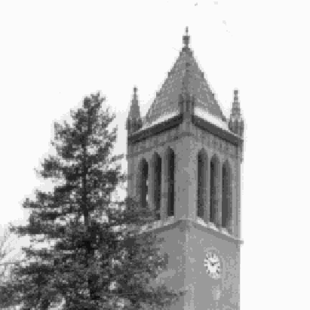
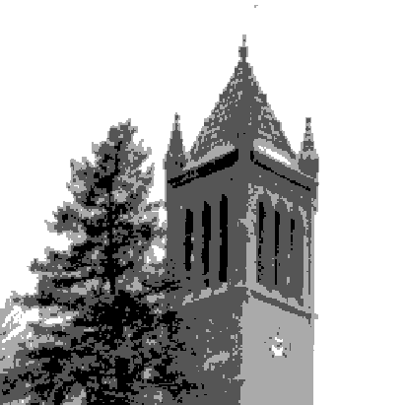
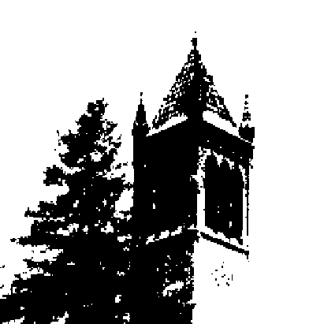
Effect of Quantization Levels (cont.)
In this image,
it is easy to see
false contour
.
16 levels
8 levels
4 levels
2 levels

Slide 20
Zooming and Shrinking
Zooming and shrinking are applied to the digital images.
Zooming corresponds to oversampling and shrinking corresponds to undersampling.
Zooming requires two steps:
  Creation of new pixel locations
  Assignment of gray levels to those new locations.
Nearest neighbor interpolation
Bilinear interpolation :v(x’,y’) = ax’ + by’ + cx’y’ + d
Image shrinking is done by row – column deletion.
To reduce aliasing effects, blurring the image before shrinking can be done.

Slide 21
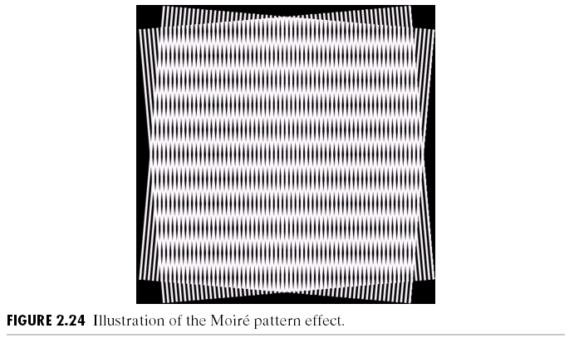
Aliasing and Moiré Patterns:
• Moire patterns occur when frequencies of two superimposed periodic patterns are close to each other.
The effect of aliasing can be seen Moiré pattern.
The principal approach for reducing the aliasing effects on an image is to reduce its high – frequency components by blurring the image prior to sampling.

